Slide 1
INFORMATION SYSTEMS
CHAPTER5
TYPE OF SYSTEM

Slide 2
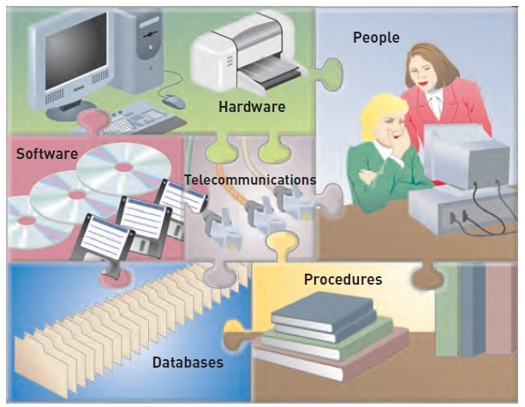
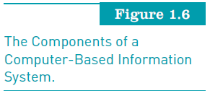
Computer-Based Information Systems
INFORMATION SYSTEMS, TENTH EDITION

Slide 3
TYPE INFORMATION SYSTEMS
What are the most common types of information systems:
  Transaction processing
  Management information
  Electronic and mobile commerce
  Decision support system
INFORMATION SYSTEMS, TENTH EDITION

Slide 4
TRANSACTION PROCESSING SYSTEMS
Transaction
  Any business-related exchange, such as payments to employees and sales to customers
Transaction processing system (TPS):
  Organized collection of people, procedures, software, databases, and devices used to record completed business transactions
  Serve operational managers and staff
  Perform and record daily routine transactions necessary to conduct business
  Examples: sales order entry, payroll, shipping
  Allow managers to monitor status of operations and relations with external environment
  Serve predefined, structured goals and decision making
INFORMATION SYSTEMS, TENTH EDITION

Slide 5
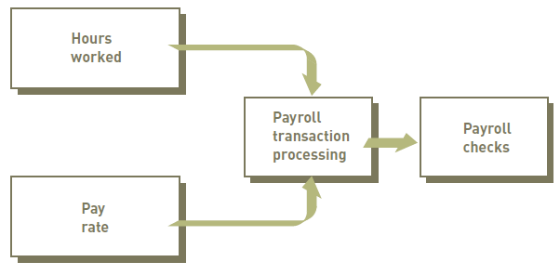
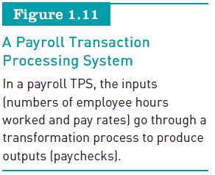
Transaction Processing Systems
INFORMATION SYSTEMS, TENTH EDITION

Slide 6
MANAGEMENT INFORMATION SYSTEM
Management information system (MIS):
  Organized collection of people, procedures, software, databases, and devices that:
    Provides routine information to managers and decision makers
  Serve middle management
  Provide reports on firm’s current performance, based on data from TPS
  Provide answers to routine questions with predefined procedure for answering them
  Typically have little analytic capability
INFORMATION SYSTEMS, TENTH EDITION

Slide 7
MANAGEMENT INFORMATION SYSTEM
  Example:
  Customer relationship management (CRM) is an approach to managing a company’s interaction with current and future customers. It often involves using technology to organize, automate, and synchronize sales, marketing, customer service, and technical support.
  Supply chain management (SCM) is the management of the flow of goods and services.[2] It includes the movement and storage of raw materials, work-in-process inventory, and finished goods from point of origin to point of consumption.
INFORMATION SYSTEMS, TENTH EDITION

Slide 8
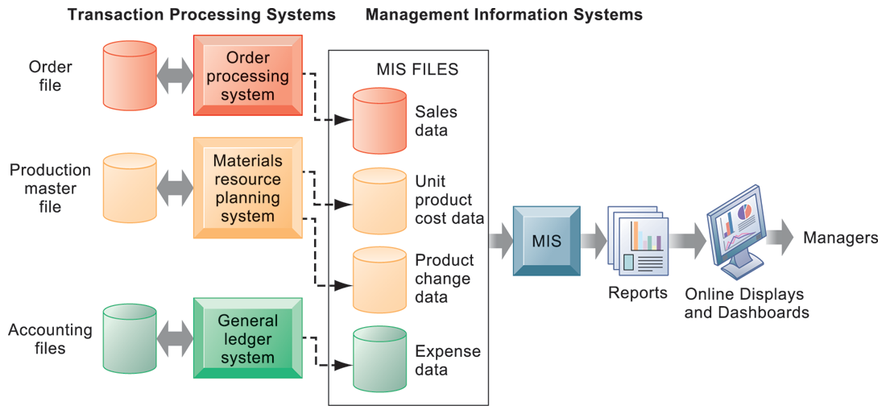
MANAGEMENT INFORMATION SYSTEM
How MIS Obtain Their Data from the Organization’s TPS
FIGURE 2-3
In the system illustrated by this diagram, three TPS supply summarized transaction data to the MIS reporting system at the end of the time period. Managers gain access to the organizational data through the MIS, which provides them with the appropriate reports.
INFORMATION SYSTEMS, TENTH EDITION

Slide 9
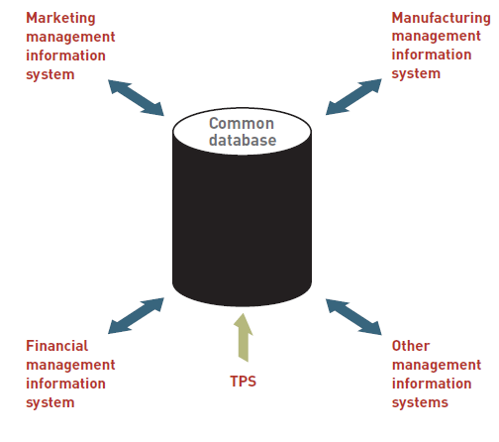
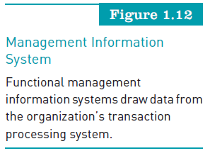
MIS
INFORMATION SYSTEMS, TENTH EDITION

Slide 10
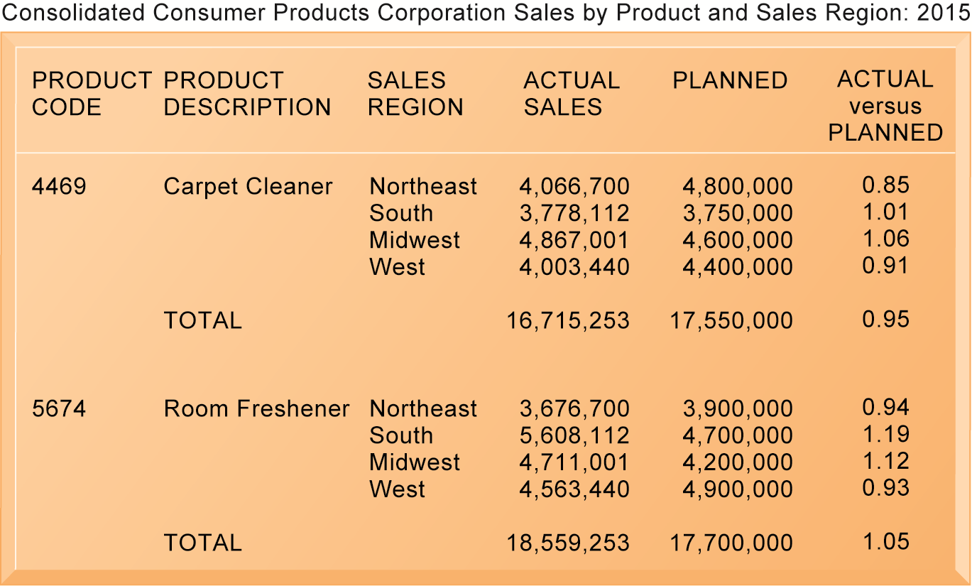
MANAGEMENT INFORMATION SYSTEM
Sample MIS Report
FIGURE 2-4
This report, showing summarized annual sales data, was produced by the MIS in Figure 2-3.
INFORMATION SYSTEMS, TENTH EDITION

Slide 11
ELECTRONIC AND MOBILE COMMERCE
E-commerce:
  Any business transaction executed electronically between:
    Companies (business-to-business, B2B)
    Companies and consumers (business-to-consumer, B2C)
    Consumers and other consumers (consumer-to-consumer, C2C)
    Business and the public sector
    Consumers and the public sector
INFORMATION SYSTEMS, TENTH EDITION

Slide 12
ELECTRONIC AND MOBILE COMMERCE (CONTINUED)
Mobile commerce (m-commerce):
  The use of mobile, wireless devices to place orders and conduct business
Electronic business (e-business):
  Uses information systems and the Internet to perform all business-related tasks and functions
INFORMATION SYSTEMS, TENTH EDITION

Slide 13
DECISION SUPPORT SYSTEMS
Decision support system (DSS):
  Organized collection of people, procedures, software, databases, and devices that support problem-specific decision making
  Used when problem is complex and information needed to determine appropriate action is difficult to obtain
INFORMATION SYSTEMS, TENTH EDITION

Slide 14
DECISION SUPPORT SYSTEMS
  Serve middle management
  Support nonroutine decision making
    Example: What is the impact on production schedule if December sales doubled?
  May use external information as well TPS / MIS data
  Model driven DSS
    Voyage-estimating systems
  Data driven DSS
    Intrawest’s marketing analysis systems
INFORMATION SYSTEMS, TENTH EDITION

Slide 15
DECISION SUPPORT SYSTEMS
  Serve middle management
  Support nonroutine decision making
    Example: What is the impact on production schedule if December sales doubled?
  May use external information as well TPS / MIS data
  Model driven DSS
    Voyage-estimating systems
  Data driven DSS
    Intrawest’s marketing analysis systems
INFORMATION SYSTEMS, TENTH EDITION

Slide 16
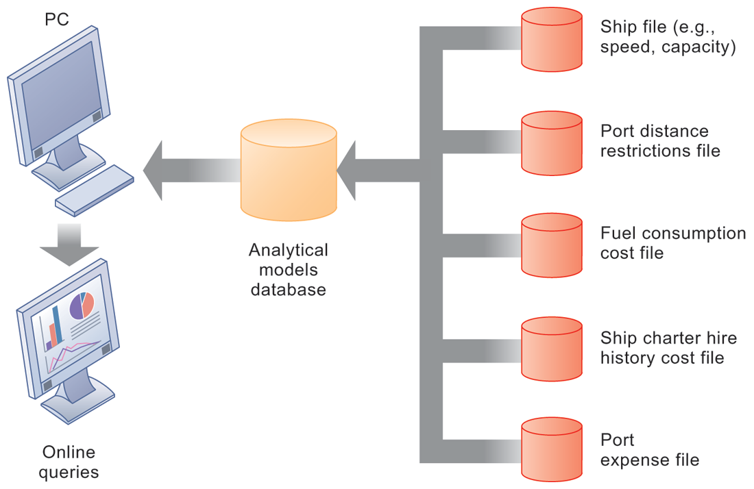
DECISION SUPPORT SYSTEMS
Voyage-Estimating Decision Support System
FIGURE 2-5
This DSS operates on a powerful PC. It is used daily by managers who must develop bids on shipping contracts.
INFORMATION SYSTEMS, TENTH EDITION

Slide 17
KNOWLEDGE MANAGEMENT SYSTEMS (KMS)
  Support processes for capturing and applying knowledge and expertise
    How to create, produce, deliver products and services
  Collect internal knowledge and experience within firm and make it available to employees
  Link to external sources of knowledge
INFORMATION SYSTEMS, TENTH EDITION

Slide 18
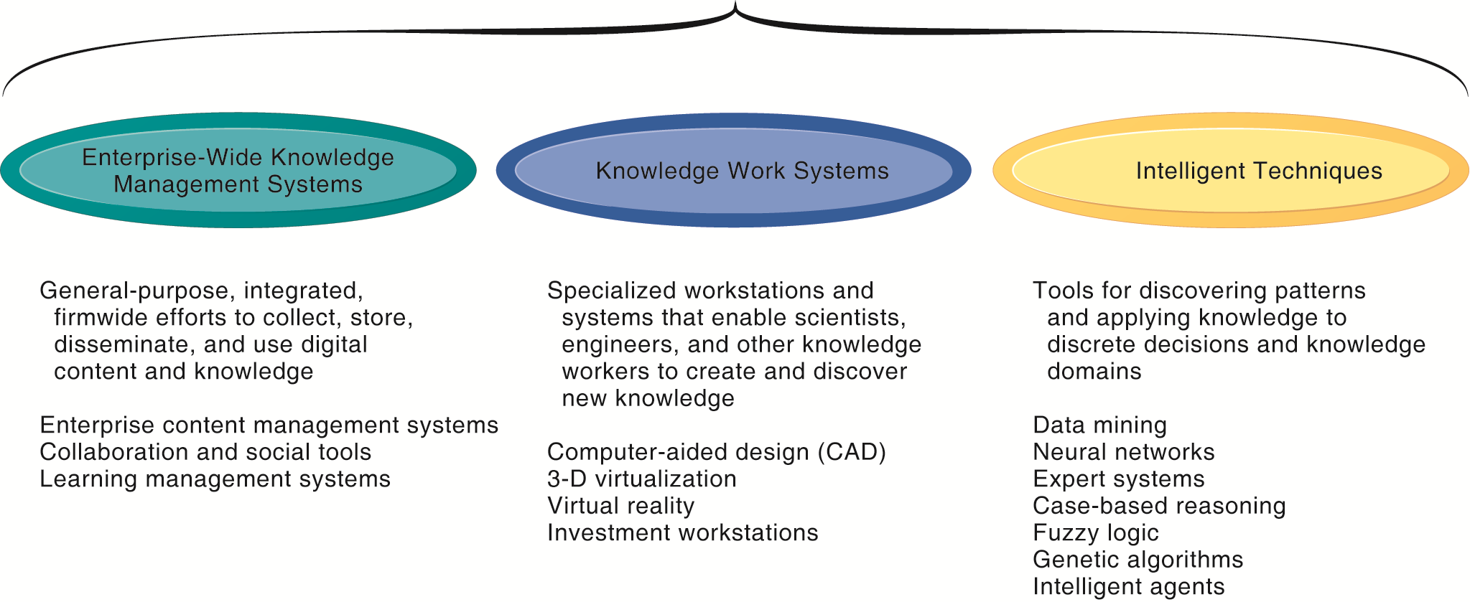
KNOWLEDGE MANAGEMENT SYSTEM
MAJOR TYPES OF KNOWLEDGE MANAGEMENT SYSTEMS
FIGURE 11-2
There are three major categories of knowledge management systems, and each can be broken down further into more specialized types of knowledge management systems.
INFORMATION SYSTEMS, TENTH EDITION

